Slide 1
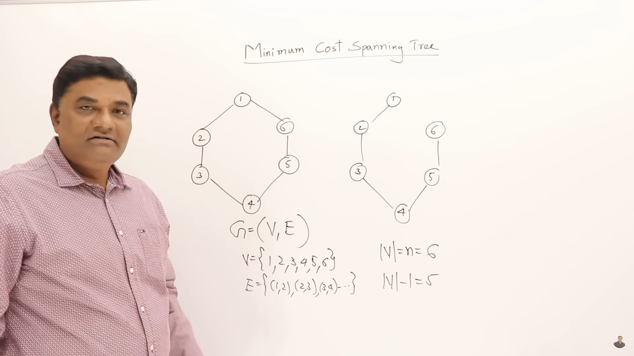
Span tree is the sub graph of graph having all vertices but only n-1 edges=>no cycle

Slide 2
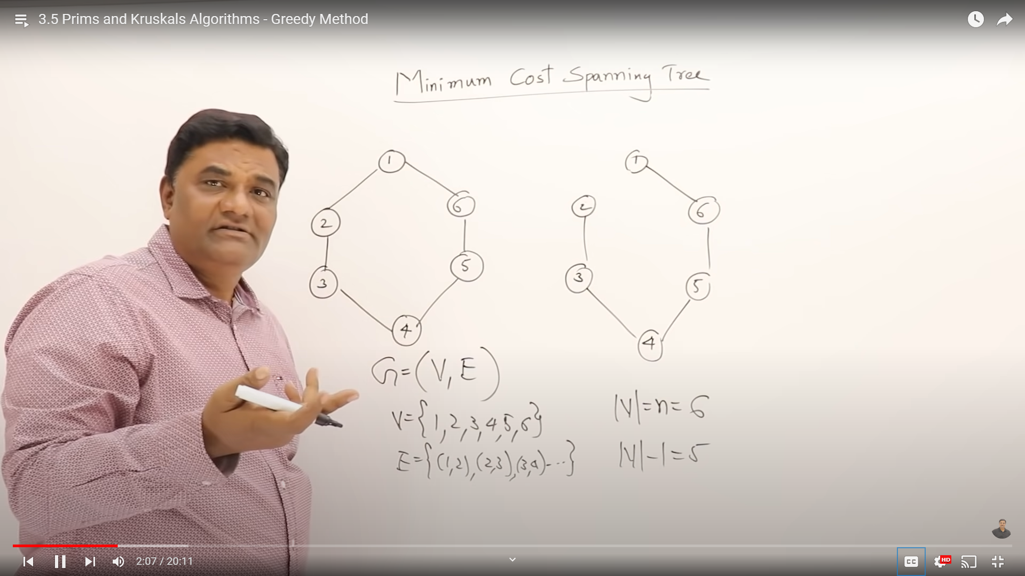
Also spanning tree

Slide 3
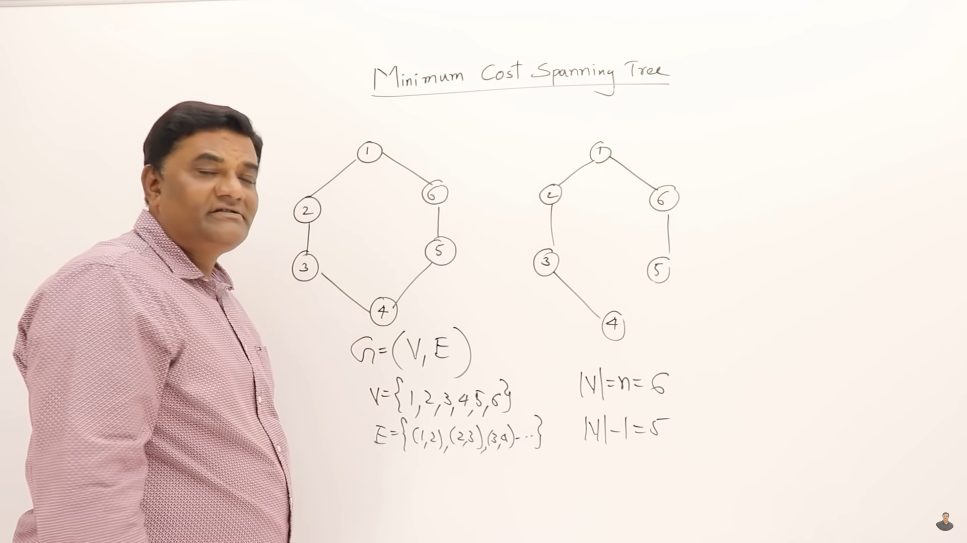
Also spanning tree

Slide 4
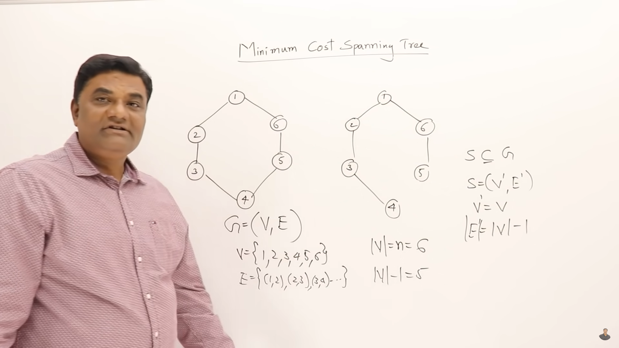
subgraph

Slide 5
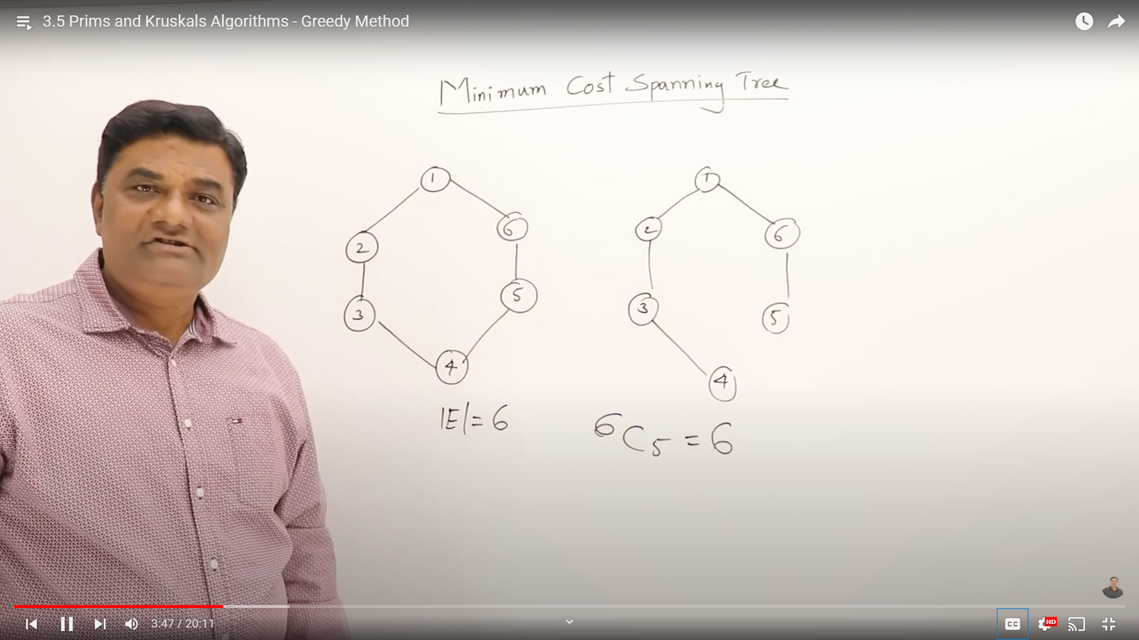
Out of 6 edges I will have to select 5

Slide 6
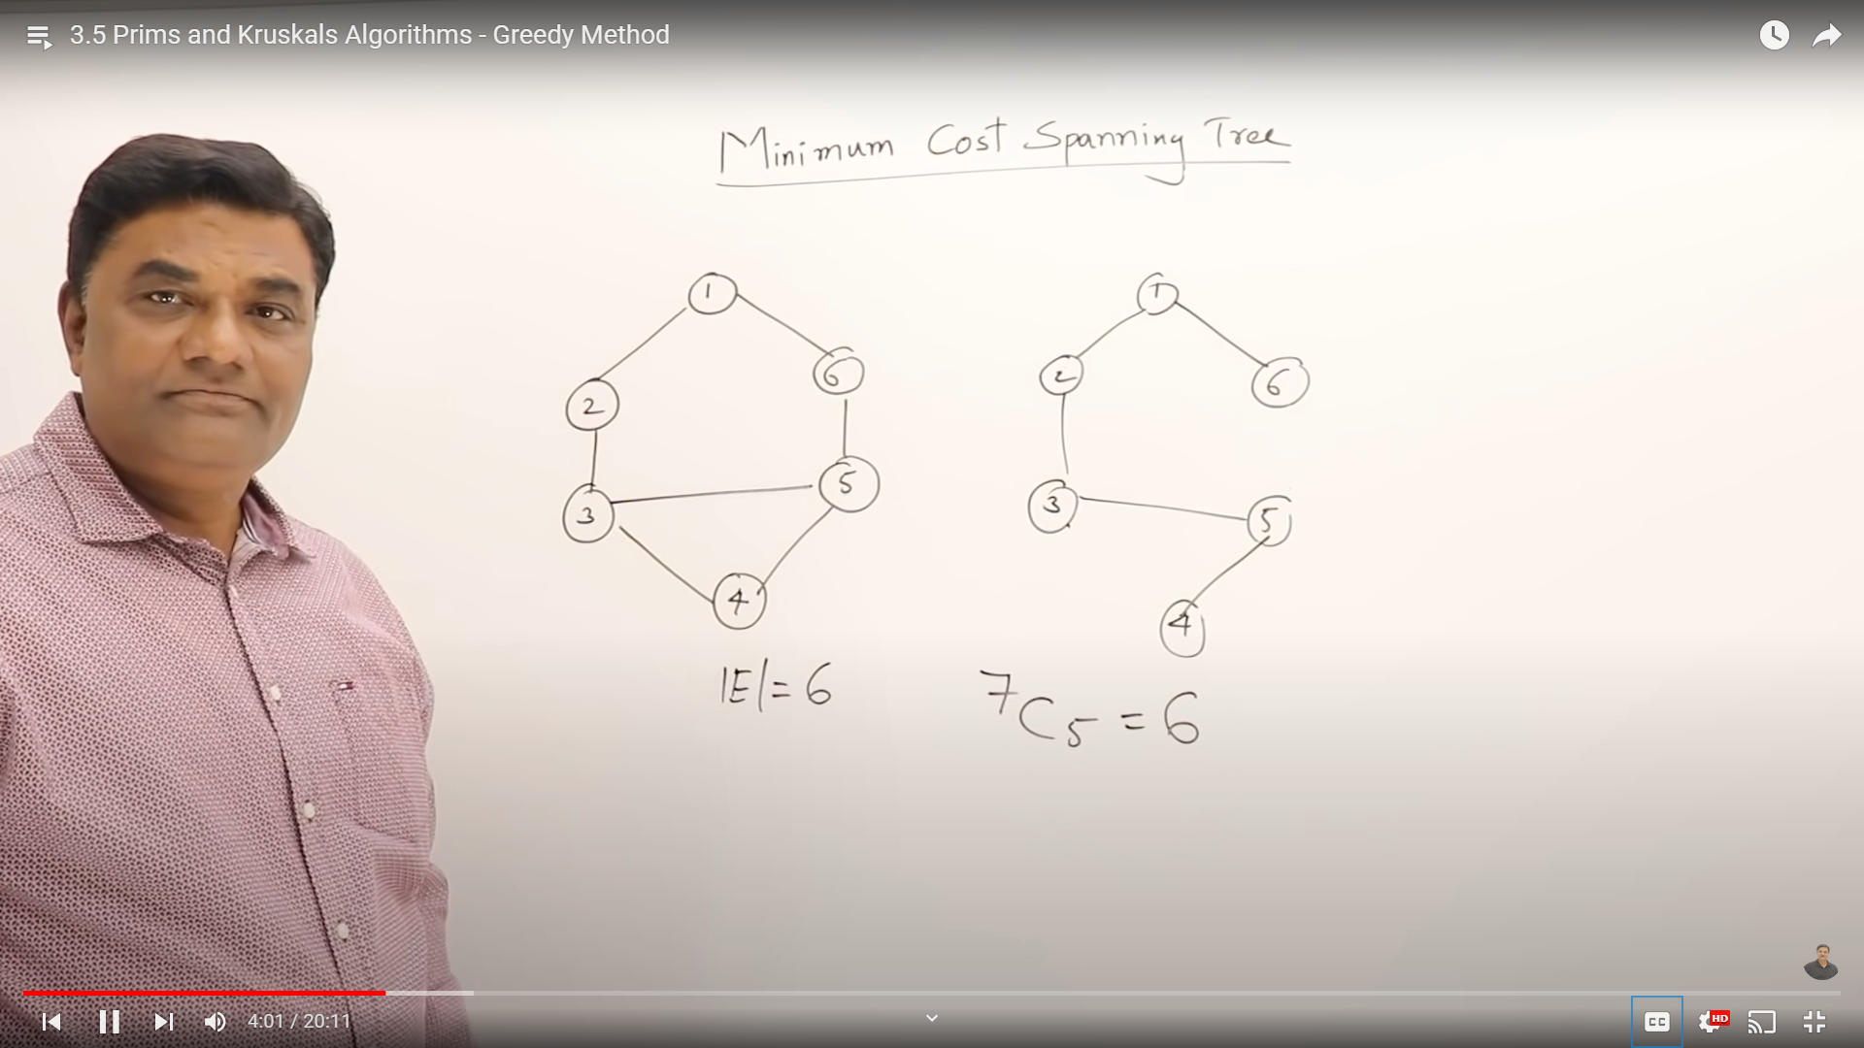

Slide 7
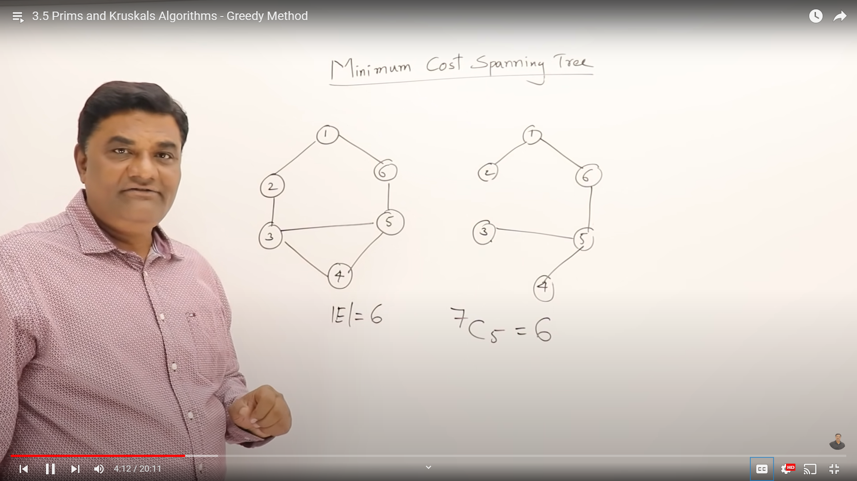

Slide 8
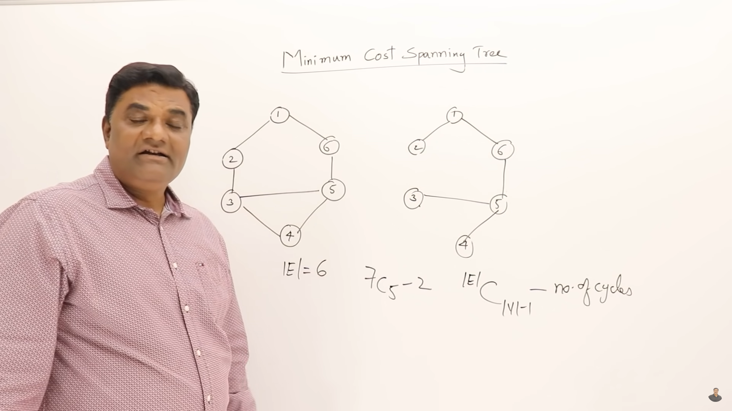
How many cycle

Slide 9
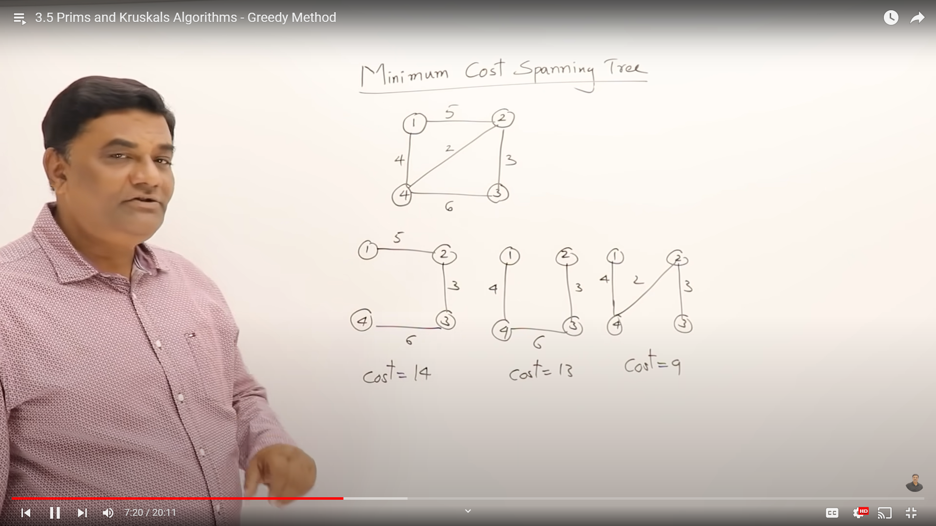
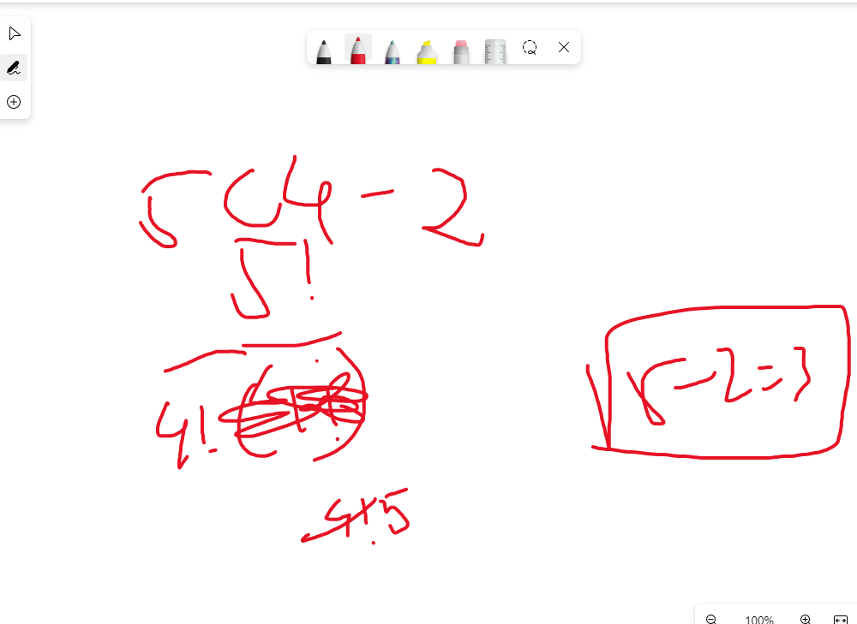

Slide 10
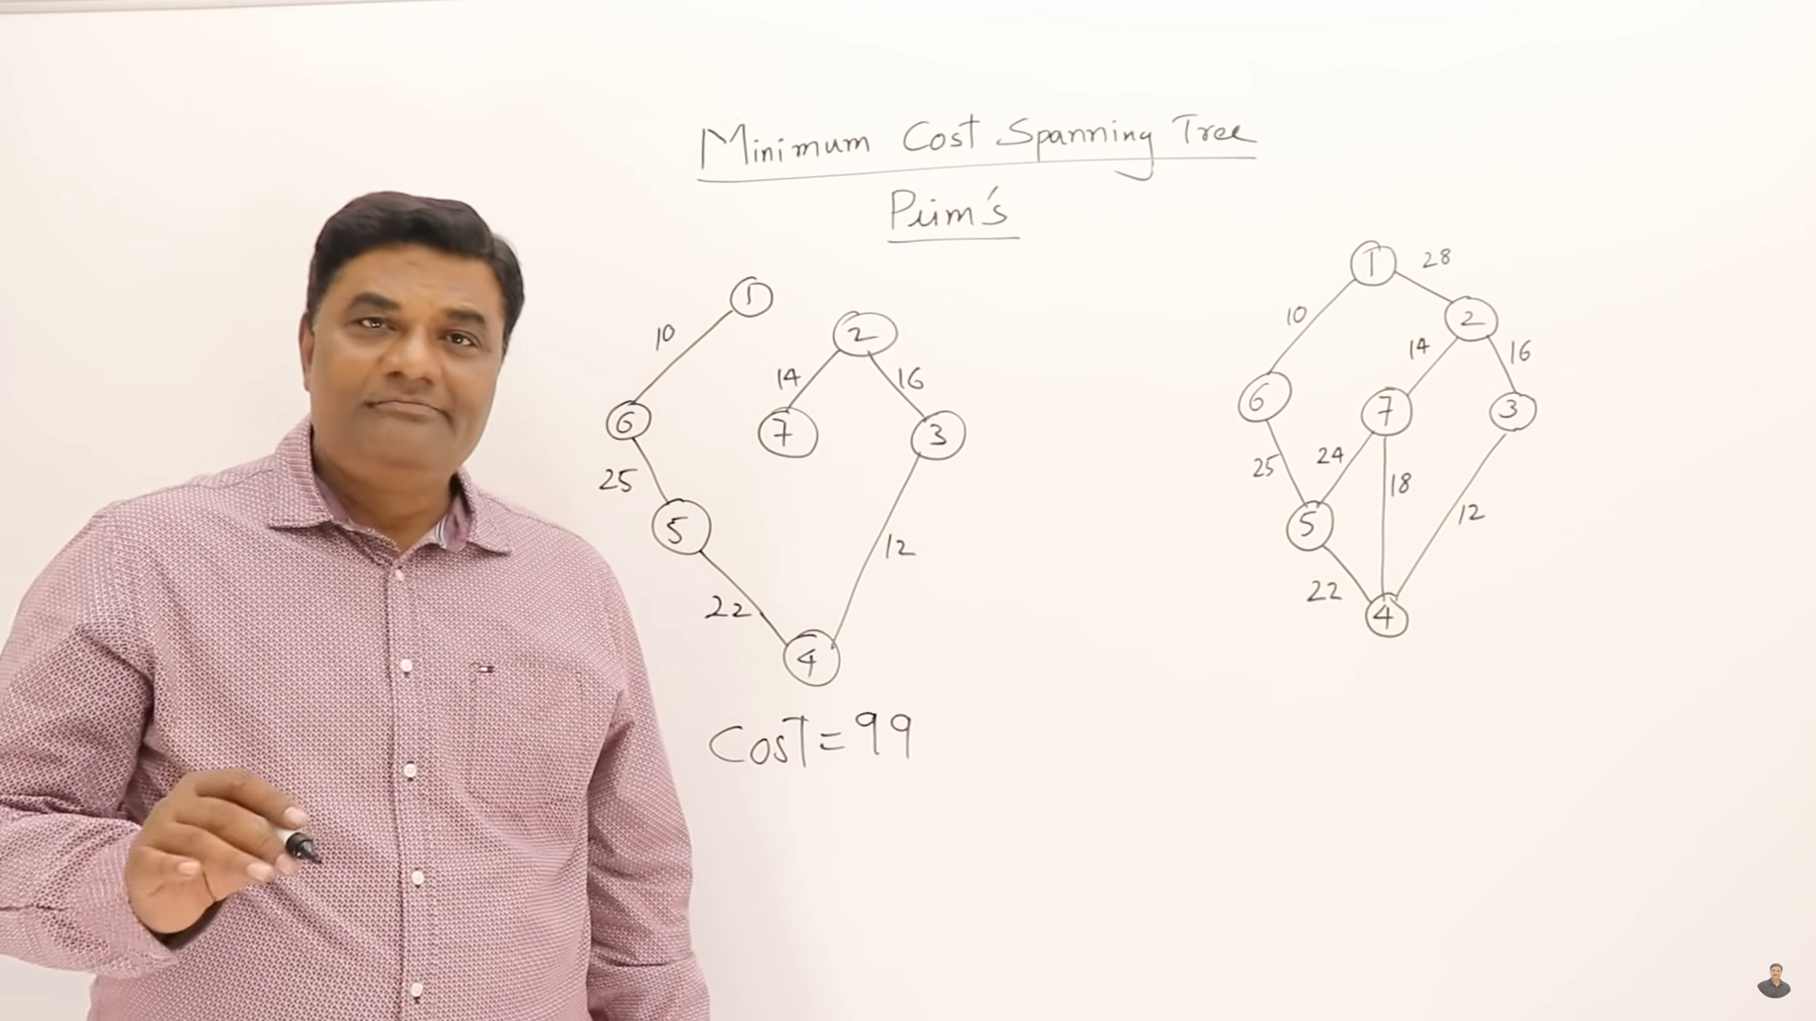
Prim’s Algorithm:
From the graph first of all you select minimum cost edges then but make sure that should be connected already selector vertices
25<28 => select 25
22<24<28=> sl 22

Slide 11
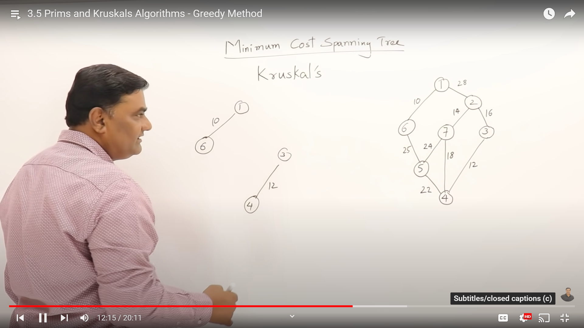
Krusal Algorithm:
Always select minimum edge but if it forming a cycle don’t include in the solution

Slide 12
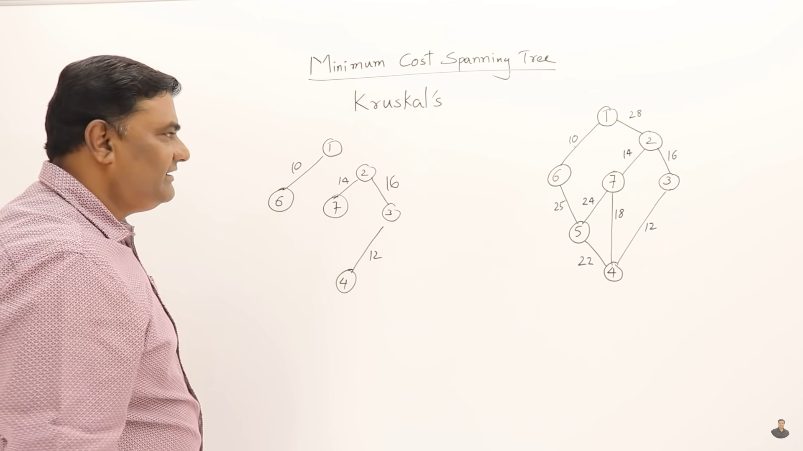

Slide 13
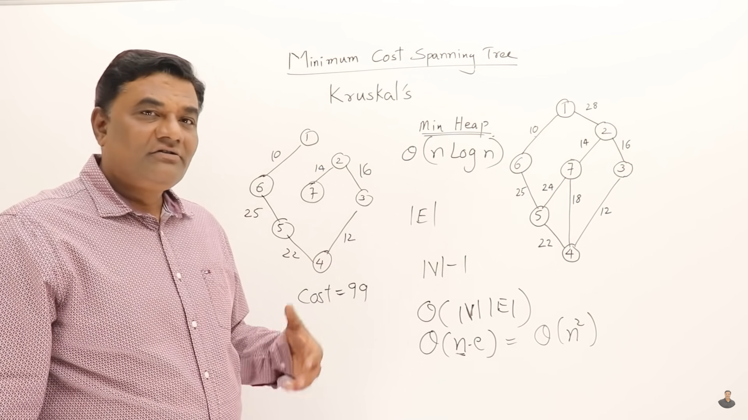

Slide 14
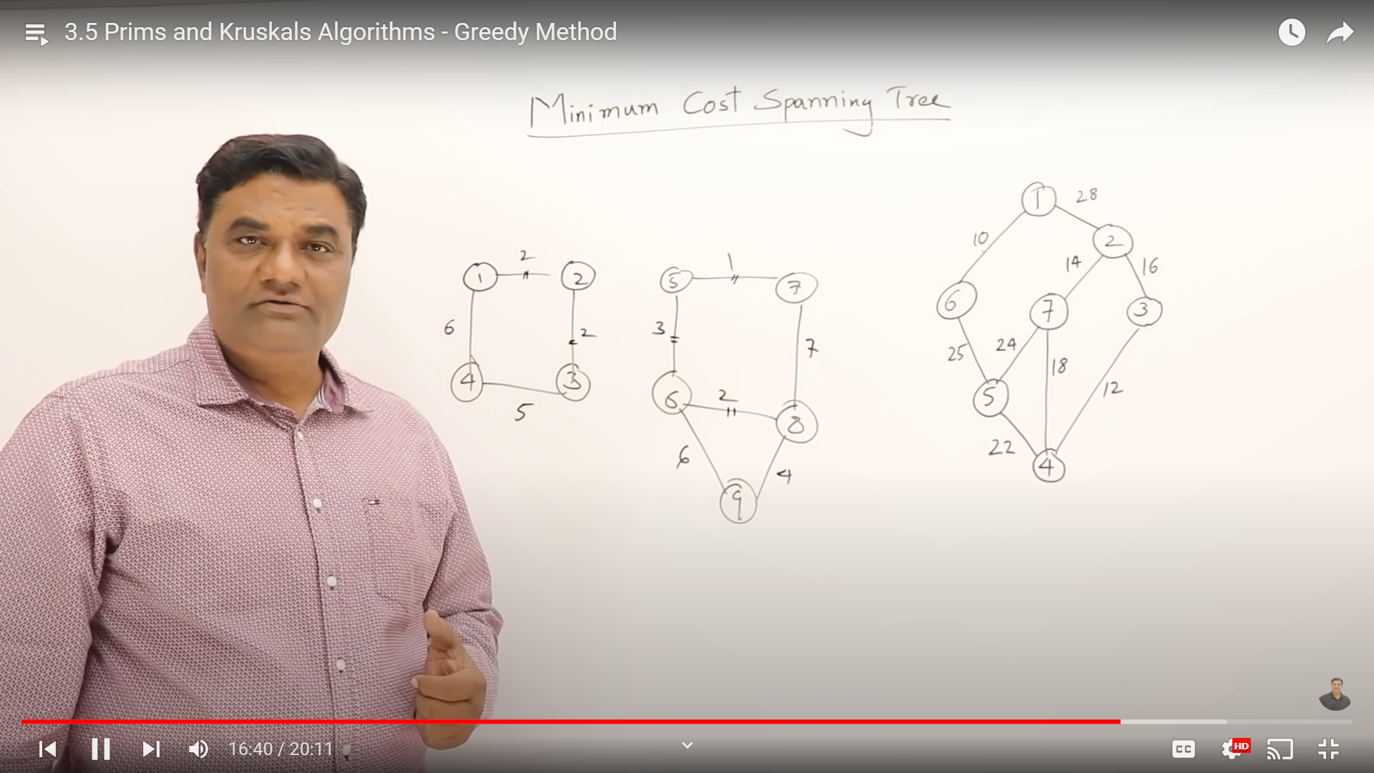

Slide 15
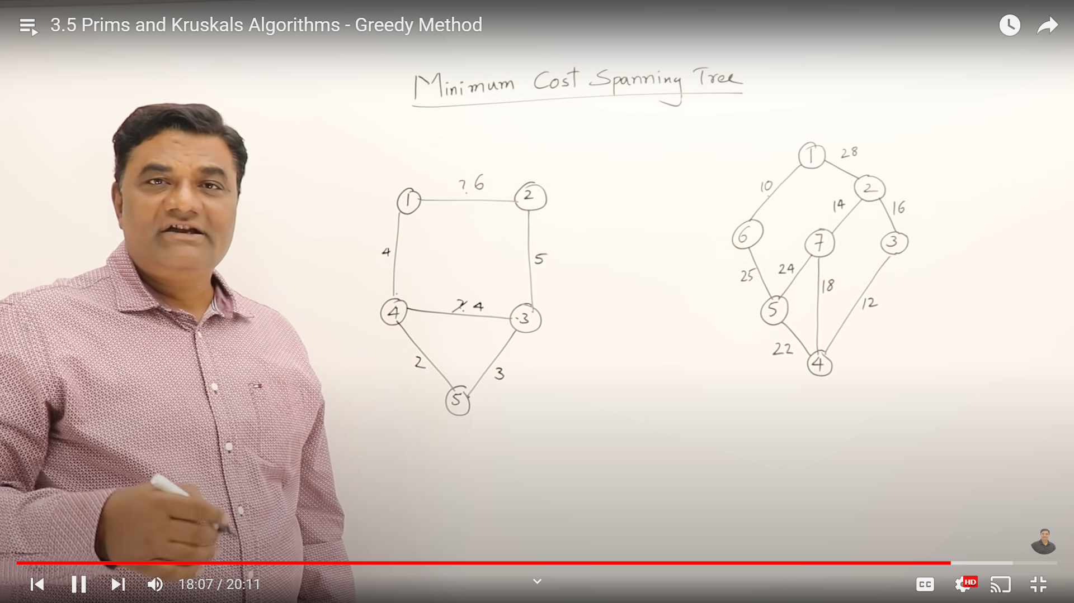

Slide 16
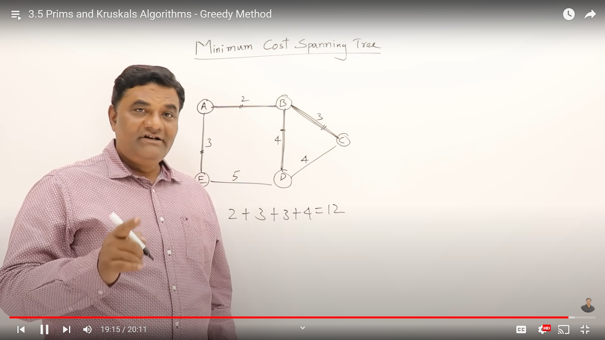

Slide 17
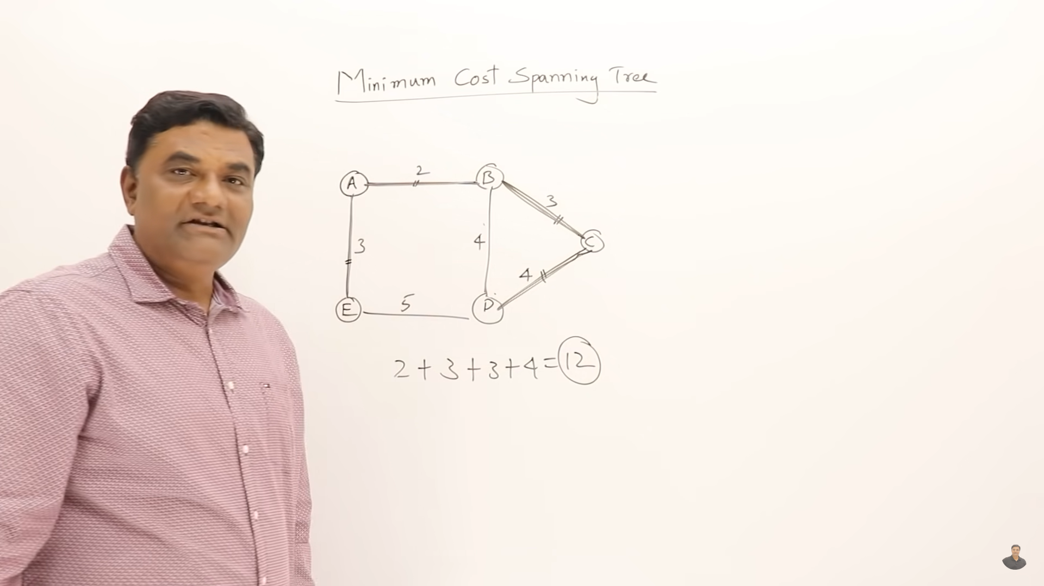

Slide 18
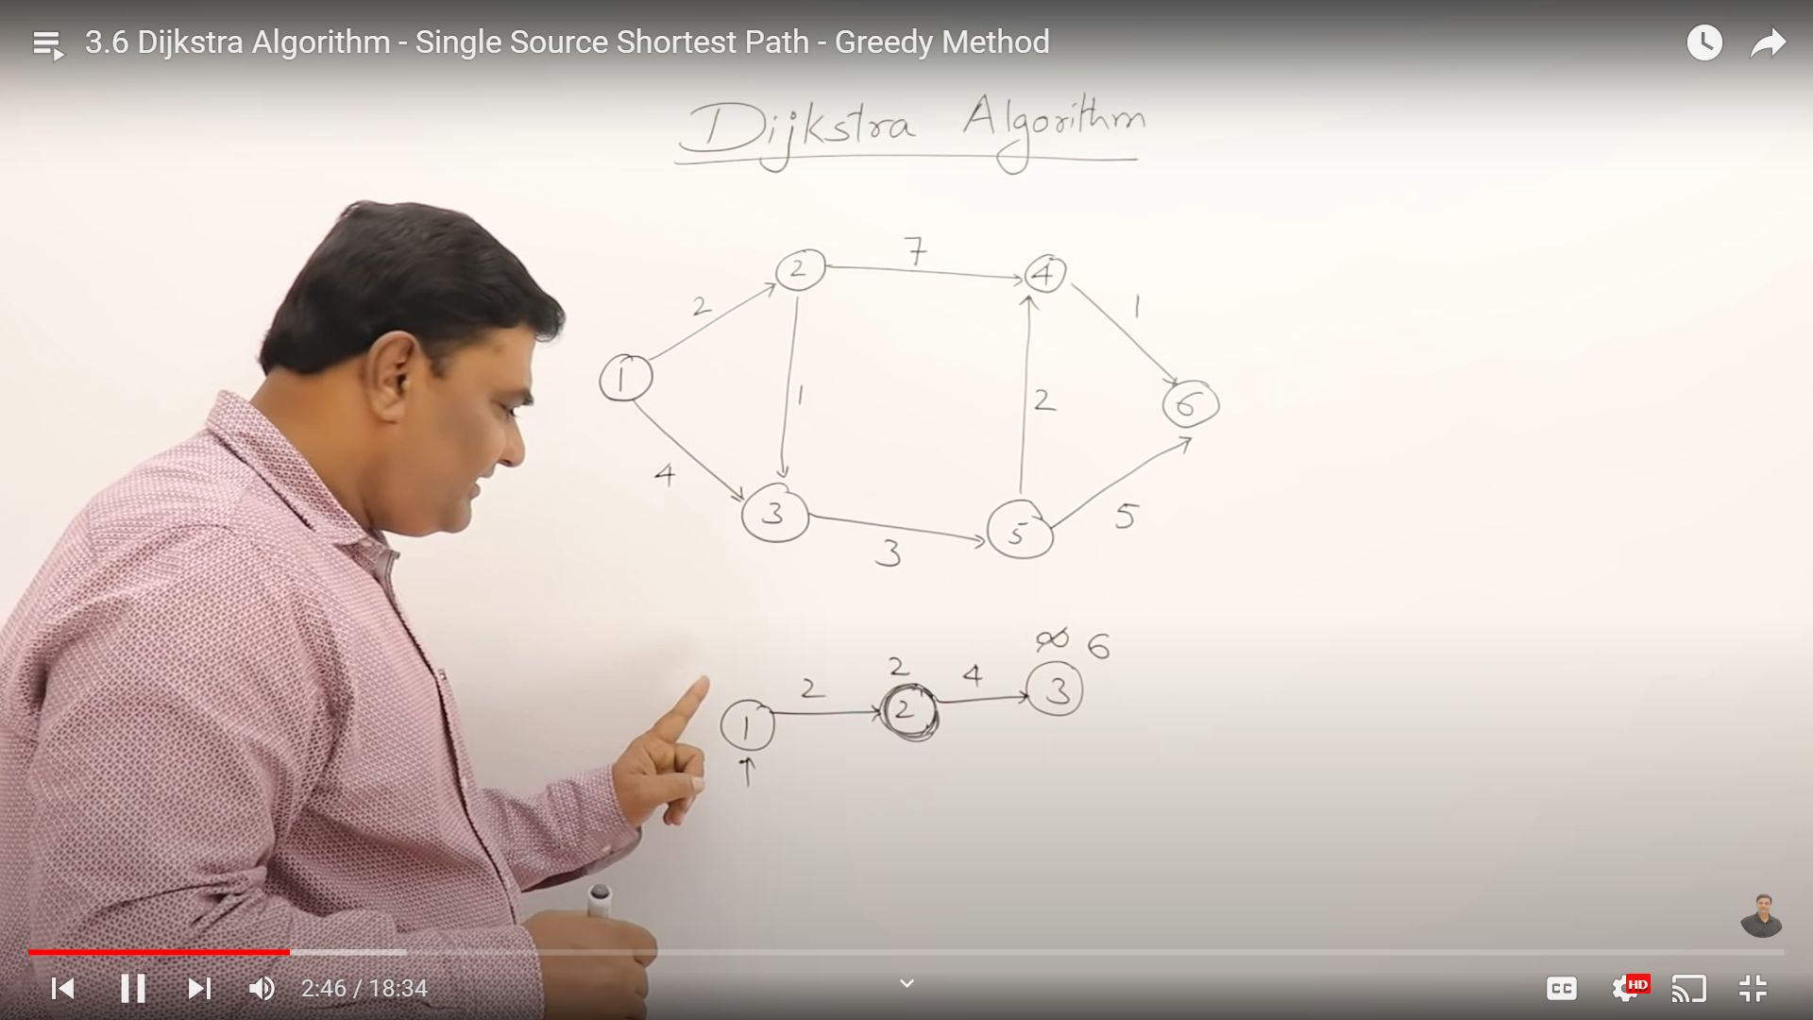
distance
distance
cost
cost
We don’t know path 1->3 ( no direct) represent infinity
We choose the shortest path 1->2 is cost 2
Directed path//graph

Slide 19
https://www.geeksforgeeks.org/prims-minimum-spanning-tree-mst-greedy-algo-5/
https://www.geeksforgeeks.org/kruskals-minimum-spanning-tree-algorithm-greedy-algo-2/

